Slide 1
Matlab程式設計_3_23
助教:金郁善

Slide 2
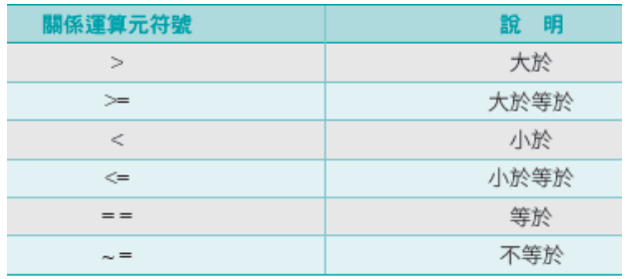
Relation operators

Slide 3
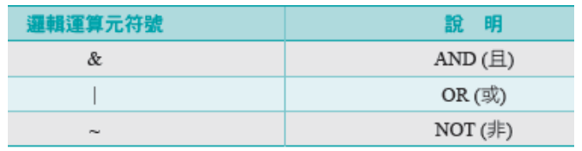
Logical operators

Slide 4
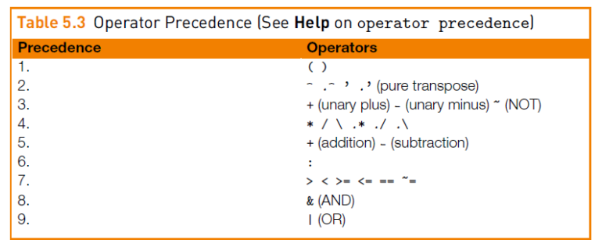
Logical functions

Slide 5
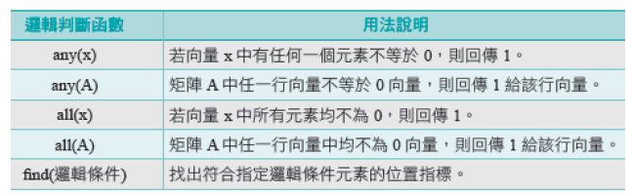
Logical functions

Slide 6
Functions for matrix operation

Slide 7
Generate the special matrix

Slide 8
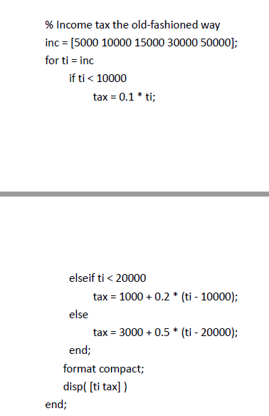
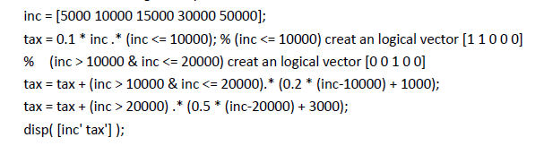

Slide 9
HOMEWORK

Slide 10
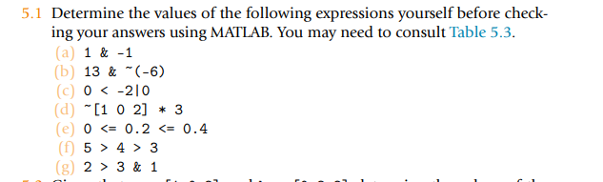

Slide 11
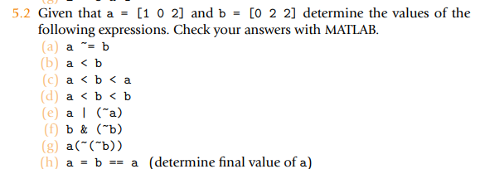

Slide 12
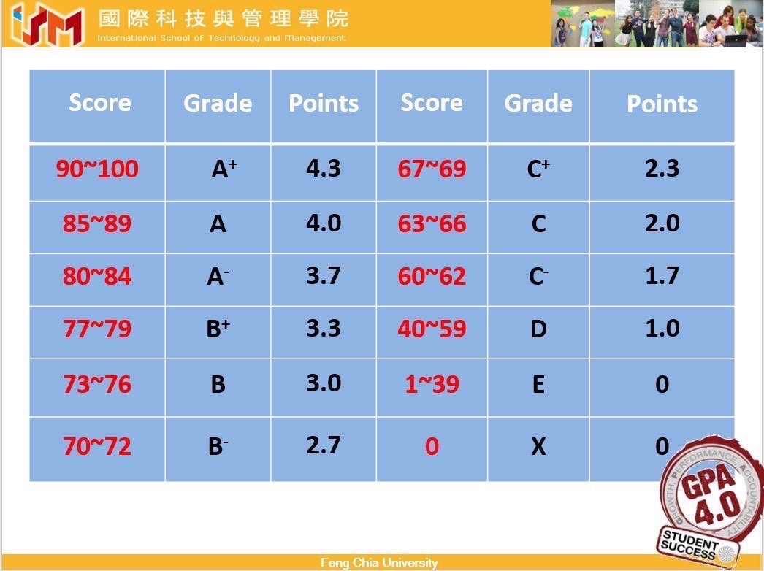
5.3 Change score.m to calculate the average GPA of students

Slide 13
N=input(' number of student: ');
score=zeros(2,N);
% input the name and score of the student evaluate the average score
for i=1:N
str1= input('student name:','s');
eval(['name',int2str(i),'=str1;']);
% if (i==1)
% name=str1;
% else
% name=char(name,str1); % Create a character array.
% end
score(1,i)=input('math score: ');
score(2,i)=input('english score: ');
avg(i)=(score(1,i)+score(2,i))/2; % avg(i) = sum(score(:,i))/2;
end
% output value
for i=1:N
eval(['str1=name',int2str(i),';']);
fprintf('the average score of %s is %3.2f \n',str1,avg(i));
end

Slide 14
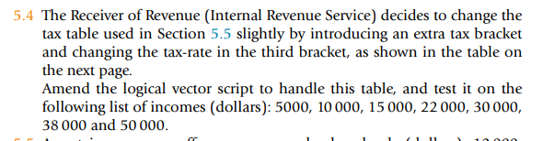
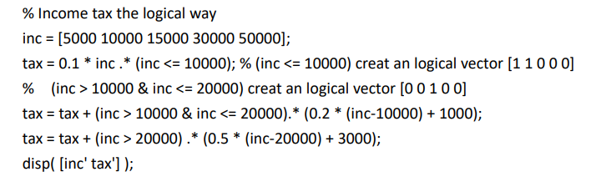

Slide 15
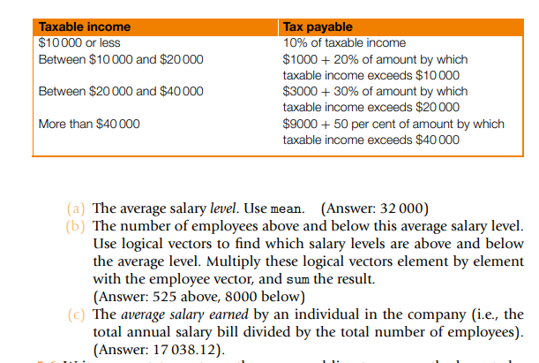

Slide 16
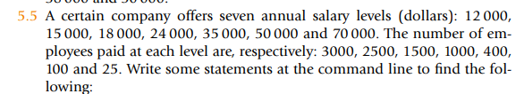

Slide 17


Slide 18
